Slide 1
深化中阿油气合作 共建能源丝绸之路
Deepening Oil and Gas Cooperation between China and League of Arab States
Building a Silk Road of Energy Jointly
November , 2018
Notes:
1

Slide 2
提纲 Outline
中国石油在阿合作情况介绍
中国石油国际化经营理念
加强中阿油气合作展望
Introduction to Cooperation between CNPC and Arab States
International Management Concept of CNPC
Suggestions for strengthening oil and gas cooperation

Slide 3
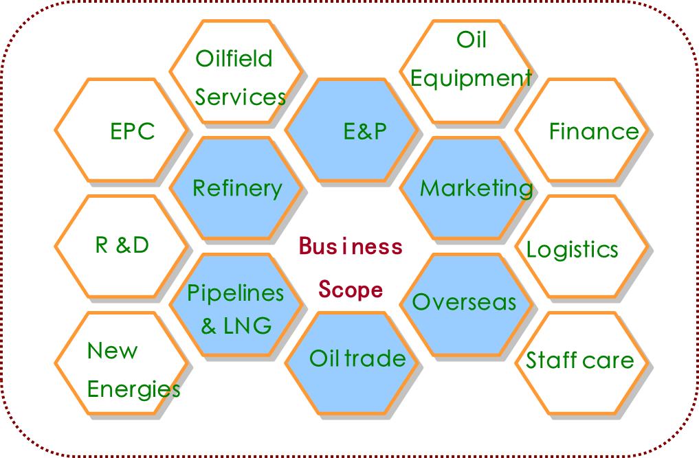
A. 中国石油在阿合作Cooperation between CNPC and Arab States
中国石油天然气集团有限公司（简称“中国石油”）是一家集油气业务、工程技术服务、石油工程建设、石油装备制造、金融服务和新能源开发于一体的综合性国际能源公司。已建成中亚-俄罗斯、中东、非洲、美洲、亚太五大油气合作区，在全球30多个国家，运作着90多个油气合作项目。
China National Petroleum Corporation (CNPC) is an integrated international energy company,
with business covering oil and gas operations, oilfield services, petroleum engineering technology and construction services, oil equipment manufacturing, financial services and new energy development.
中国主要油气生产商和供应商之一
世界50家大石油公司排名第 3 位
财富全球500强排名第 4 位
One of China's major oil and gas producers and suppliers
Rank No.3 in the world's 50 major oil companies
Rank No.4 in Fortune Global 500

Slide 4
A. 中国石油在阿合作Cooperation between CNPC and Arab States
目前，中国石油在阿盟7个国家，管理和运作19个油气合作项目，原油年生产能力超过1亿吨。同时在阿盟11个国家开展工程技术和工程建设服务。
Operating 19 projects in 7 member states of Arab League. Current crude oil production
capacity: 100 million tons （720 million barrels）per year.
In Iraq: CNPC carries out all-round cooperation in oil and gas investment, crude oil trade, engineering services and equipment export. CNPC has made positive contributions for the reconstruction and development of Iraq's oil and gas industry.
In UAE: CNPC has four projects in Abu Dhabi with other international oil companies. The production capacity of the four projects is expected to reach 1 billion barrels per year in the future.
Tunisia：1 project
Syria：2 projects
Iraq：4 projects
UAE：4 projects
Oman：1 project
Sudan ：6 projects
Algeria：1 project
In Sudan: CNPC has been cooperating with Sudan for more than 20 years. A complete modern petroleum industrial system has been established in Sudan. The peak crude oil production capacity of CNPC projects has ever exceeded 16 million tons（115 million barrels） per year. The petroleum cooperation achievements have been highly appraised by the leaders of the two countries and praised as "a model of China-Sudan cooperation and South-South cooperation".

Slide 5
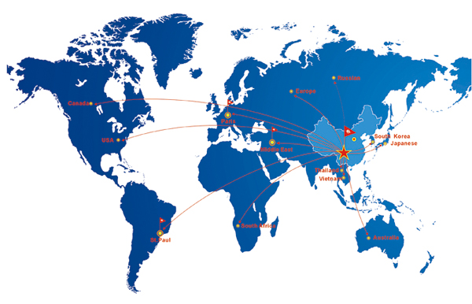
B. 国际化经营理念 International Management Concept
1. 坚持全球化，为国际业务制定恰当的发展战略
Insist on globalization. Generate proper development strategy for overseas business.
优化全球资源配置，灵活规划战略布局。以竞争求合作，以合作促超越。
Optimize the allocation of worldwide resources and plan the strategy lay-out smartly. Cooperate in competition and surpass in cooperation.
紧抓全球合作机会
Seize worldwide cooperation opportunity
通过评估外界机会和自身优势，为国际化投资作出合理决策
Decide proper mode for international investment by valuing the opportunity and with self-advantages
以国际化视野优化资源配置
全球视角下的战略规划
Optimize the allocation of resources from international perspective
Strategy planning with global perspective

Slide 6
B. 国际化经营理念 International Management Concept
2. 坚持专业化——精细化管理和高效运营机制相结合
Insist on specialization. Combine the delicacy management and efficient operating mechanism
1
设立子公司和分公司管理组织架构
Set subsidiary and branch management organizational structure
2
建立有效的项目管控机制
Establish effective project control mechanism and maximize the social and economic benefits
3
围绕标准化目标，规范各流程标准
Targeting standardization, CNPC insists implying the unified standards and procedures in personnel, IT, financing, etc.
4
遵守第三方监督，保证项目质量
Under international supervision for the security, adhere to the third party supervision, guarantee project quality and schedule operating under control

Slide 7
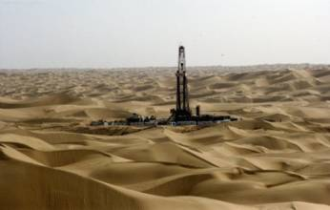
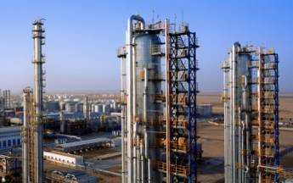
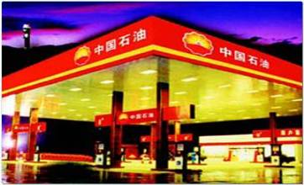
B. 国际化经营理念 International Management Concept
3. 坚持差异化——在国际化经营中培养核心竞争力
Insist on differentiation. Cultivate core competitive power in international operation
1）提供差异化技术支持和管理 Provide differential technical support and management
利用一体化优势和技术基础，同时吸收国际先进技术和体系
Make use of the integration advantage and technique foundation,
meanwhile absorb the international advanced technology and system
2）提供差异化商业模型 Provide differential business model
为东道主国家提供完整的解决方案，并帮助其建立石油工业 Provide entire solutions for the host countries to establish their own petroleum industry
最大化整体利润，提升能源、经济与社区的协同发展 Maximize the entire profit and promote the coordinated development of the energy, economy and community.

Slide 8
B. 国际化经营理念 International Management Concept
4. 坚持项目导向型经营——建立合同导向型运营和管理机制
Insist on project-oriented operation. Establish contract-oriented operation and management mechanism
国际化经营模式
采取国际项目经营和操作实践 Adopts the international project operations and operational practices
遵守国际项目的全过程管理 Obey the whole process management of international projects
International operation pattern
视合同为宪法
建立并提升商业标准和合同模式 Establish and improve the business standard forms of contract
搭建合同管理信息系统 Construct the contract management information system
Regard the contract as Constitution
为每类项目建立独特的经营模型
为不同国家和项目探索独特的经营和管理模型 Explore unique operating and management models for different countries and projects
降低项目经营风险、加速项目建设并提高生产的经济效益 Reduce project operating risks, speed up the project construction, and improve the economic benefits of production
Establish unique operation model for each type of projects

Slide 9
B. 国际化经营理念 International Management Concept
5. 坚持一体化——充分发挥CNPC集团公司综合优势
Insist on integration. Make full use of the integration advantages of CNPC parent company
国际化经营过程中，坚持依靠中国石油人才、技术和资本整体优势，坚持统一协调、统一安排、相互提升和支持的原则，全力推进国际化经营管理。
Rely on the advantages on personnel, technique and capital of the parent company. Adhere to the united coordination, unified scheduling, mutual promotion and support principle. Push forward the international operation.

Slide 10
B. 国际化经营理念 International Management Concept
6. 坚持本土化——坚持双赢原则来全面实行本土化方针
Insist on localization. Insist win-win principle to practice localization
1）遵守当地法律并尊重当地文化习俗
Abide by laws and be respect to the local customs and culture
遵守资源国法律政策
Obey the laws and policy of the host countries
提倡尊重、开放和兼容的国际企业文化
Advocate respected, open & compatible international enterprise culture
打造多种中方员工与当地人员的交流平台
Provide variety of communication platforms for Chinese employees and local personnel.
2）做资源国政府企业可靠的合作伙伴
To be a reliable partner to the host government and enterprise
充分考虑多方利益，与资源国共建互利环境
Take into account the interests of all parties to form a mutual benefit community with the host country

Slide 11
B. 国际化经营理念 International Management Concept
6. 坚持本土化——坚持双赢原则来全面实行本土化方针
Insist on localization. Insist on win-win principle to practice localization
3）履行企业的社会责任
Fulfill corporate social responsibility
秉持“做一个世界的好公民”的社会责任理念
Adhering to the concept of social responsibility “to be a good citizen of the world"
支持当地社会福利保障事业
Support the local social welfare undertakings
促进社会发展、生态环境保护以及和谐社区环境的建立
To promot social development, environmental protection and harmonious community

Slide 12
B. 国际化经营理念 International Management Concept
7. 建立内部控制和HSSE管理系统，重视海外投资风险管理
Establish internal control & HSSE management system and emphasis overseas investment risk management
建立内部控制和风险防范控制系统，全方面覆盖海外运营领域
Building internal control and risk prevention & control system covering the field of overseas operations
建立有效的安全防护保护系统和应急反应机制
Establishing efficient security prevention & control system and emergency response mechanism
建立国际标准的HSSE管理机制
Building the HSSE management mechanism under international standards

Slide 13
B. 国际化经营理念 International Management Concept
8.坚持以人为本的核心理念，提供国际化专业化的人员培训
Insist on people oriented idea. Provide internationalized and specialized personnel training
发展雇员的本地化和国际化
Advancing employees’ localization and internationalization
当地雇员
Local Employees
国际雇员
International Employees
激励当地雇员发挥主观能动性
Motivating local employees to perform their own advantages
提供在当地、中国和第三国家的培训提升雇员技能
Providing local training and training in China and third country to upgrade their skills
以国际化运营为导向引进高端国际化人才
Introducing high-level international talent oriented to international operation
依照国际惯例和资源国法律法规 Abiding by international norms and the host country laws

Slide 14
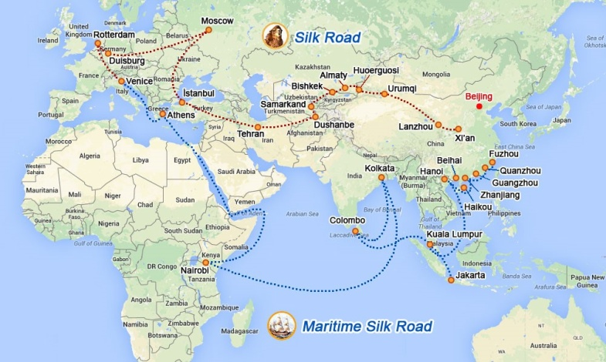
C. 合作展望Suggestions for strengthening oil and gas cooperation
1. 响应“一带一路”倡议，不断深化中阿油气合作领域和深度
阿拉伯国家处于陆上丝绸之路和海上丝绸之路的交汇处，是中国石油国际化经营的核心区域，建议中阿双方积极响应“一带一路”倡议，持续加深、加强中阿油气合作水平
1. Respond to the “one belt and one way” initiative ， expand the oil and gas cooperation scope between China and Arab States
Arab States is located at the intersection of the“land Silk Road” and the “maritime Silk Road”，which is the core area of CNPC's international operation.
It is suggested that China and Arab States actively respond to the "one belt and one road" initiative and continue to deepen and strengthen oil and gas cooperation

Slide 15
C. 合作展望Suggestions for strengthening oil and gas cooperation
2. 发挥互补优势，实现互利共赢
中国石油在大型油气田勘探开发、提高采收率、长距离管道、炼油及化工、工程技术及建设、装备制造等领域具有丰富经验，是阿拉伯国家优质合作伙伴
阿拉伯国家国际合作环境将更加开放、更加包容
2. Exploiting advantages of each，achieving win-win cooperation
CNODC’s ability：Exploration and development of large oil and gas fields, EOR, long distance pipelines, refining and chemicals, engineering technology, engineering construction, equipment manufacturing
Arabia's international cooperation environment will be more open

Slide 16
C. 合作展望Suggestions for strengthening oil and gas cooperation
3. 共同关注风险，提升项目价值
需要合作伙伴之间加强沟通交流，建立起更加完备的风险防控机制，确保项目的顺利开展和运行，确保项目效益的稳步提升
3. Attach Great Importance to the Prevention and Control of Various Risks
Social Security Incidents
Terrorist attacks
Establish risk prevention and control mechanisms
Strengthen communication

Slide 17
Work together for a grand blueprint for oil and gas cooperation between China and Arab States and for a better tomorrow for the “Silk Road Economic Belt”!
Thank you all!

